Slide 1
Richard Nixon
From Wikipedia, the free encyclopedia
https://en.wikipedia.org/wiki/Richard%20Nixon
Licensed under CC BY-SA 3.0:
https://en.wikipedia.org/wiki/Wikipedia:Text_of_Creative_Commons_Attribution-ShareAlike_3.0_Unported_License

Slide 2
Richard Nixon
Richard Milhous Nixon (January 9, 1913 – April 22, 1994) was an American politician who served as the 37th president of the United States from 1969 until 1974.
Nixon was born in Yorba Linda, California.
Nixon was elected to the House of Representatives in 1946 and to the Senate in 1950.
Nixon served for eight years as Vice President, becoming the second-youngest vice president in history at age 40.

Slide 3
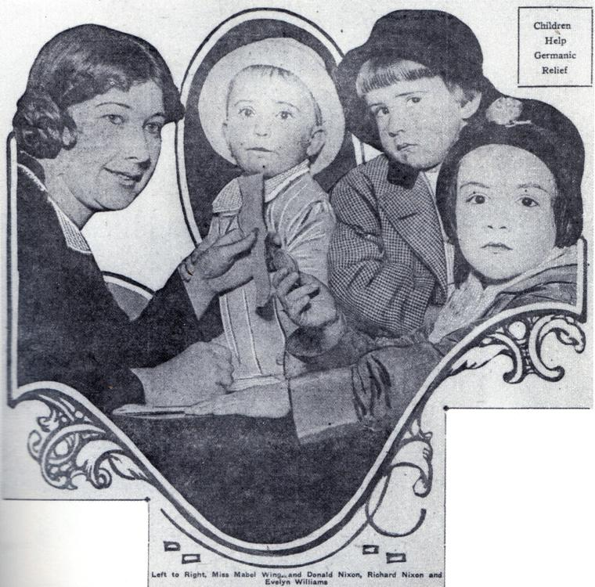
Nixon (second from right) makes his newspaper debut in 1916, contributing five cents to a fund for war orphans.

Slide 4
Early life
His parents were Hannah (Milhous) Nixon and Francis A. Nixon.
The Nixon family ranch failed in 1922, and the family moved to Whittier, California.

Slide 5
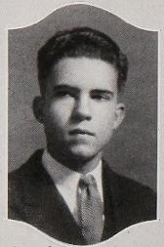
Nixon at Whittier High School, 1930

Slide 6
Primary and secondary education
Nixon later remembered Sheller's words, "Remember, speaking is conversation ... don't shout at people.
Nixon stated that he tried to use the conversational tone as much as possible.
At Whittier, Nixon suffered his first election defeat when he lost his bid for student body president.

Slide 7
College and law school education
Nixon played for the basketball team; he also tried out for football but lacked the size to play.
Nixon was snubbed by the only one for men, the Franklins; many members of the Franklins were from prominent families, but Nixon was not.
After his graduation from Whittier in 1934, Nixon received a full scholarship to attend Duke University School of Law.

Slide 8
Early career and marriage
After graduating from Duke, Nixon initially hoped to join the FBI.
In later years, Nixon proudly stated that he was the only modern president to have previously worked as a practicing attorney.
Nixon described it in his memoirs as "a case of love at first sight"—for Nixon only, as Pat Ryan turned down the young lawyer several times before agreeing to date him.

Slide 9
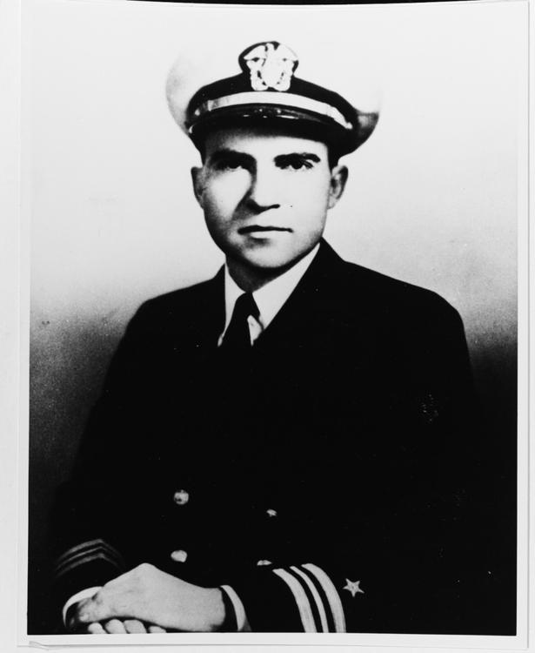
Lieutenant Commander Richard Nixon, United States Navy (circa 1945)

Slide 10
World War II
Both Nixon and his wife believed he was limiting his prospects by remaining in Whittier.
But instead of exploiting his circumstance, Nixon sought a commission in the navy.
On October 1, 1943, Nixon was promoted to lieutenant.
Later, Nixon was transferred to other offices to work on contracts and finally to Baltimore.

Slide 11
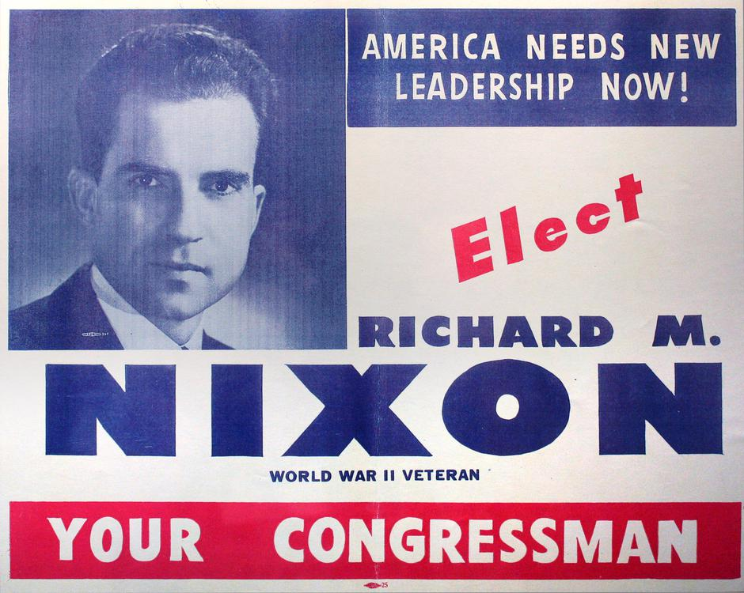
Nixon's congressional campaign flyer

Slide 12
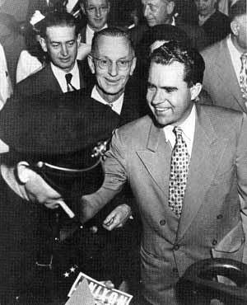
Nixon campaigning for the Senate, 1950

Slide 13
House of Representatives
Perry wrote to Nixon in Baltimore.
Nixon flew to California and was selected by the committee.
When he left the Navy at the start of 1946, Nixon and his wife returned to Whittier, where Nixon began a year of intensive campaigning.
(The Nixon Library cites this bill's passage as Nixon's first significant victory in Congress.)

Slide 14
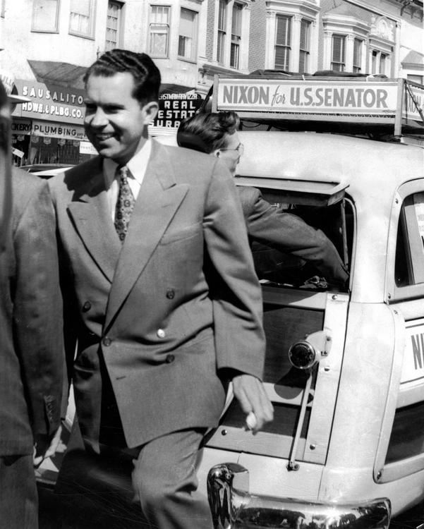
Nixon on his "station wagon tour" in Sausalito, California, 1950

Slide 15
Senate
Nixon tried to focus attention on Douglas's liberal voting record.
Nixon won the election by almost twenty percentage points.
During this campaign, Nixon was first called "Tricky Dick" by his opponents for his campaign tactics.
Nixon also criticized President Harry S. Truman's handling of the Korean War.

Slide 16
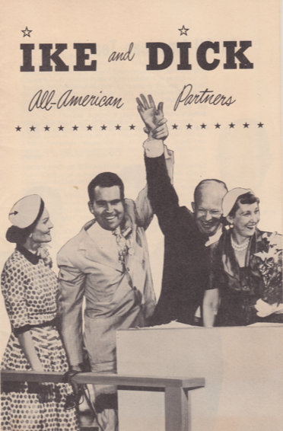
Front cover of literature for the Eisenhower–Nixon campaign, 1952

Slide 17
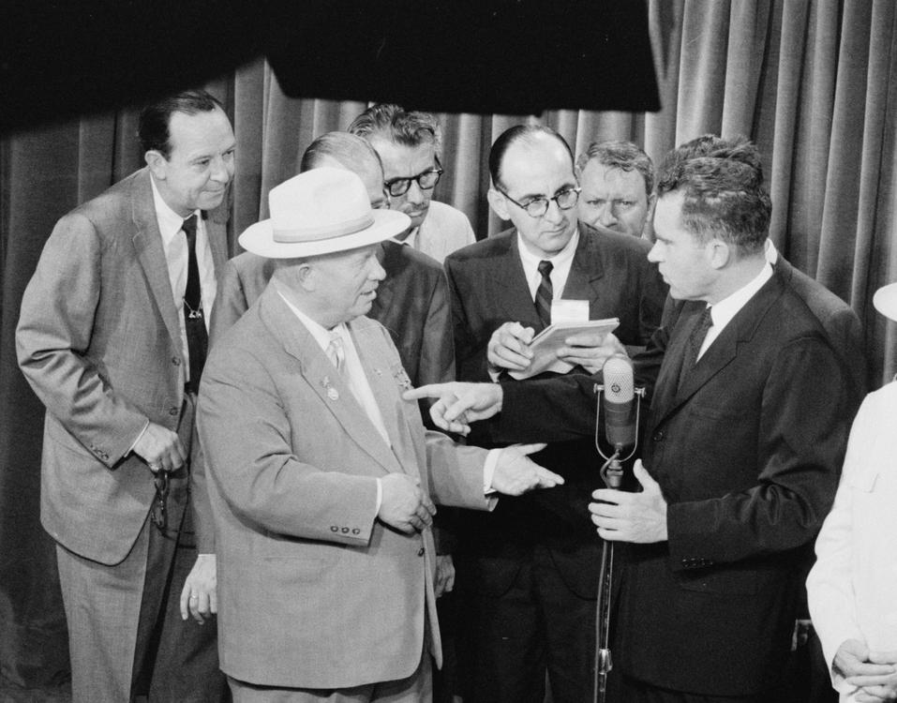
Vice President Nixon and Soviet Premier Nikita Khrushchev speak as the press looks on in part of what came to be known as the Kitchen Debate, July 24, 1959.

Slide 18
Vice presidency (1953–1961)
According to Nixon biographer Stephen Ambrose, Nixon had "earned the high praise he received for his conduct during the crisis ... he made no attempt to seize power".
In late April, the President announced that Nixon would again be his running mate.
Nixon advised the President to sign the bill, which he did.

Slide 19
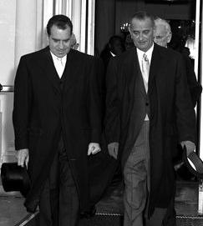
Outgoing Vice President Nixon and incoming Vice President Lyndon Johnson leave the White House on the morning of January 20, 1961, for the Kennedy–Johnson inauguration ceremonies

Slide 20
1960 and 1962 elections; wilderness years
In 1960 Nixon launched his first campaign for President of the United States.
Nixon's performance in the debate was perceived to be mediocre in the visual medium of television, though many people listening on the radio thought that Nixon had won.
In 1963 the Nixon family traveled to Europe, where Nixon gave press conferences and met with leaders of the countries he visited.

Slide 21
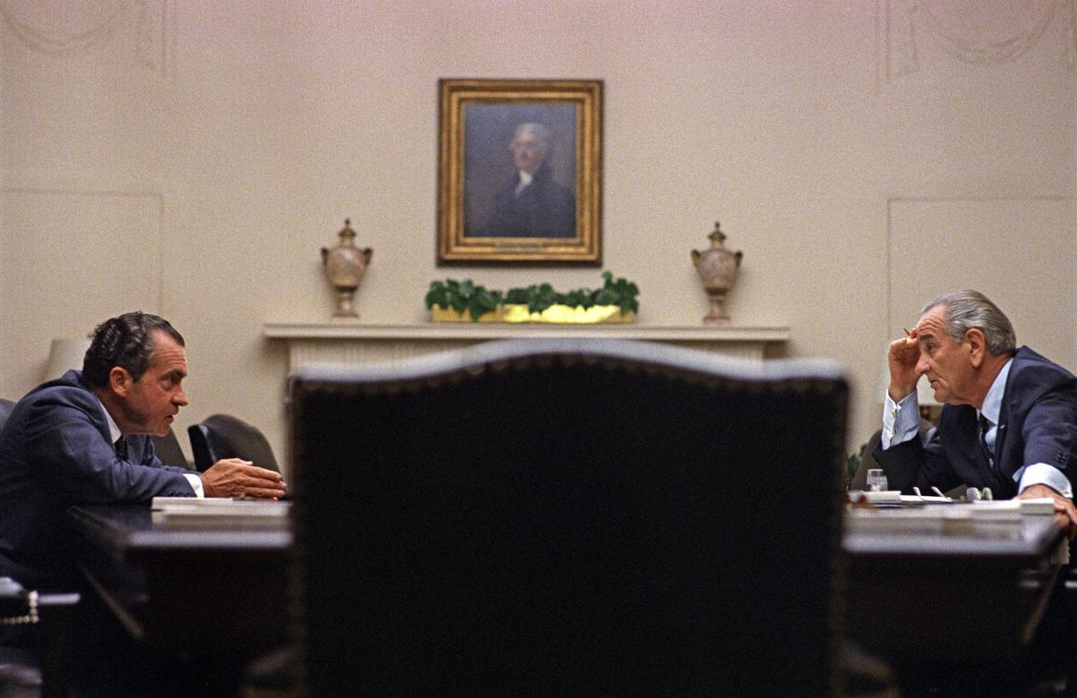
Nixon and Johnson meet at the White House before Nixon's nomination, July 1968.

Slide 22
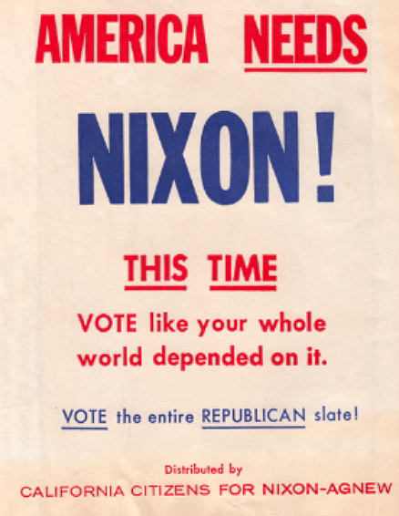
Text on automobile trash bag given away by the Nixon campaign in California, 1968

Slide 23
1968 presidential election
At the end of 1967, Nixon told his family he planned to run for president a second time.
Nixon secured the nomination on the first ballot.
His slogan of "Nixon's the One" proved to be effective.
Nixon said: "I have received a very gracious message from the Vice President, congratulating me for winning the election.

Slide 24
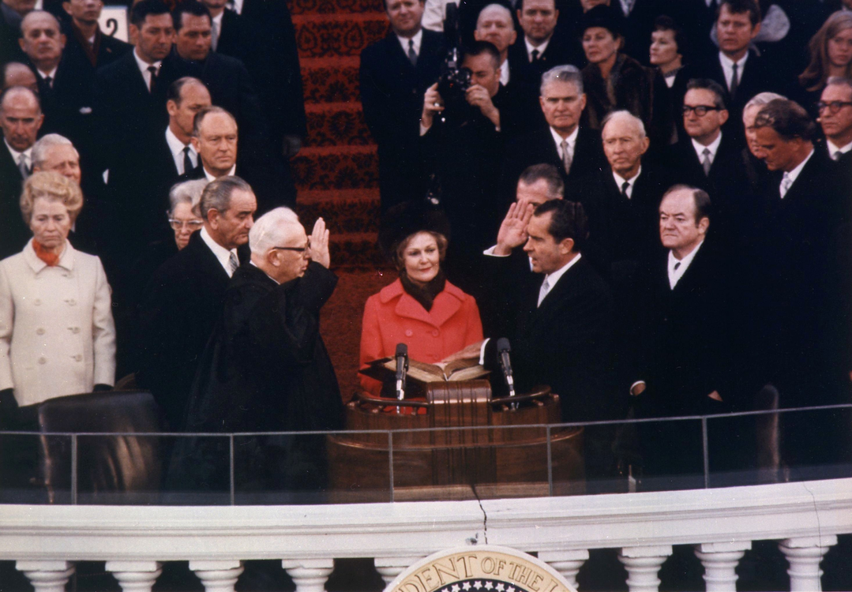
Nixon is sworn in as the 37th President by Chief Justice Earl Warren on January 20, 1969, with the new First Lady, Pat, holding the family Bibles.

Slide 25
Presidency (1969–1974)
Nixon was inaugurated as president on January 20, 1969, sworn in by his onetime political rival, Chief Justice Earl Warren.
Pat Nixon held the family Bibles open at Isaiah 2:4, which reads, "They shall beat their swords into plowshares, and their spears into pruning hooks."
In his inaugural address, which received almost uniformly positive reviews, Nixon remarked that "the greatest honor history can bestow is the title of peacemaker"—a phrase that would later be placed on his gravestone.

Slide 26
Foreign policy
The relationship between Nixon and Henry Kissinger, his National Security Advisor was unusually close.
Historian David Rothkopf has compared the personalities of Nixon and Kissinger:
Nixon very much a classic American.

Slide 27
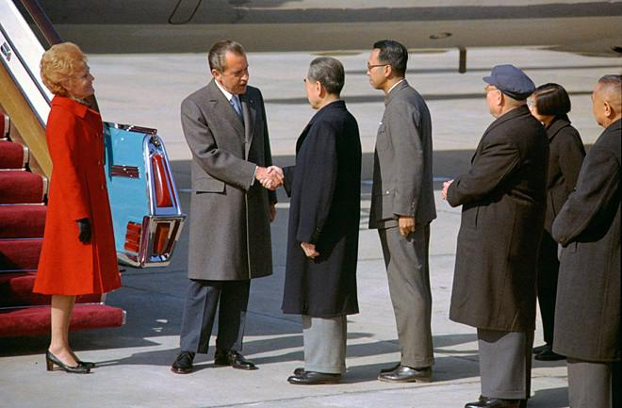
President Nixon shakes hands with Chinese Premier Zhou Enlai upon arriving in Beijing, 1972

Slide 28
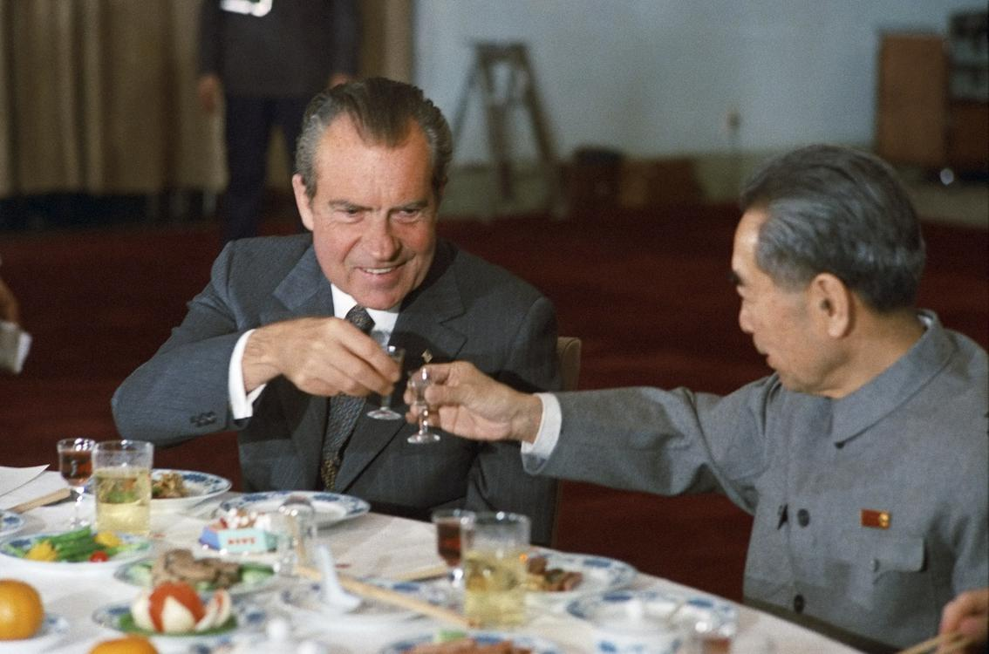
Nixon and Chinese Premier Zhou Enlai toast during Nixon's 1972 visit to China

Slide 29
China
Nixon followed up by sending Kissinger to China for clandestine meetings with Chinese officials.
In February 1972, Nixon and his wife traveled to China.
Kissinger briefed Nixon for over 40 hours in preparation.
On Nixon's orders, television was strongly favored over printed publications, as Nixon felt that the medium would capture the visit much better than print.

Slide 30
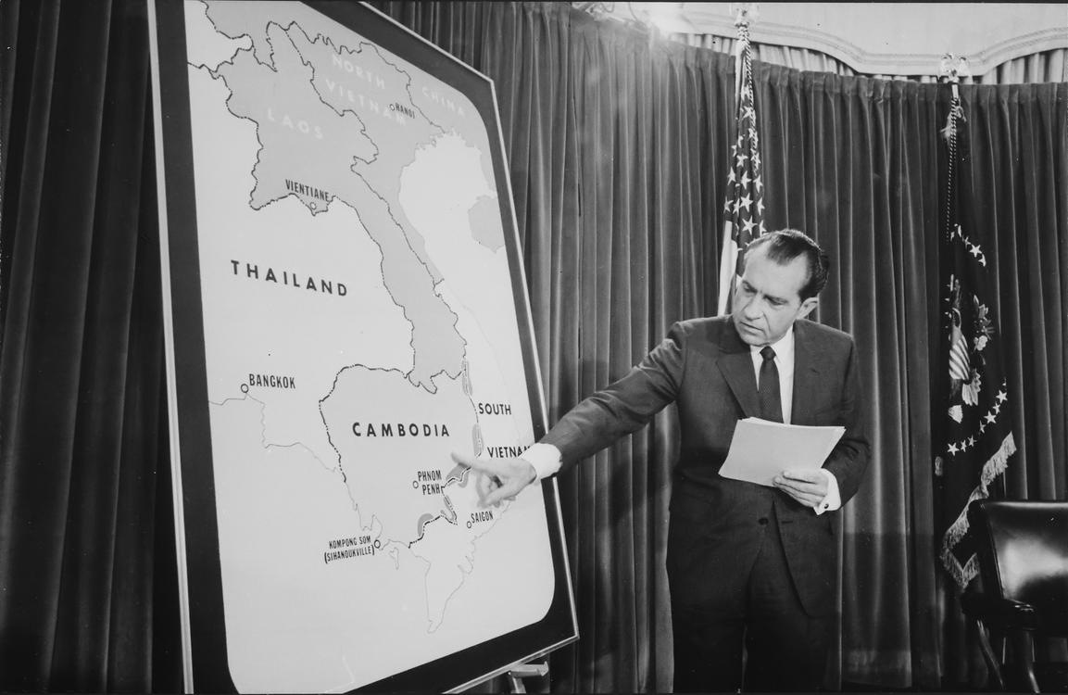
Nixon delivers an address to the nation about the incursion in Cambodia

Slide 31
Nixon visits American troops in South Vietnam, July 1969

Slide 32
Vietnam War
In July 1969, Nixon visited South Vietnam, where he met with his U.S. military commanders and President Nguyễn Văn Thiệu.
Nixon announced the ground invasion of Cambodia to the American public on April 30, 1970.
Nixon's campaign promise to curb the war, contrasted with the escalated bombing, led to claims that Nixon had a "credibility gap" on the issue.

Slide 33
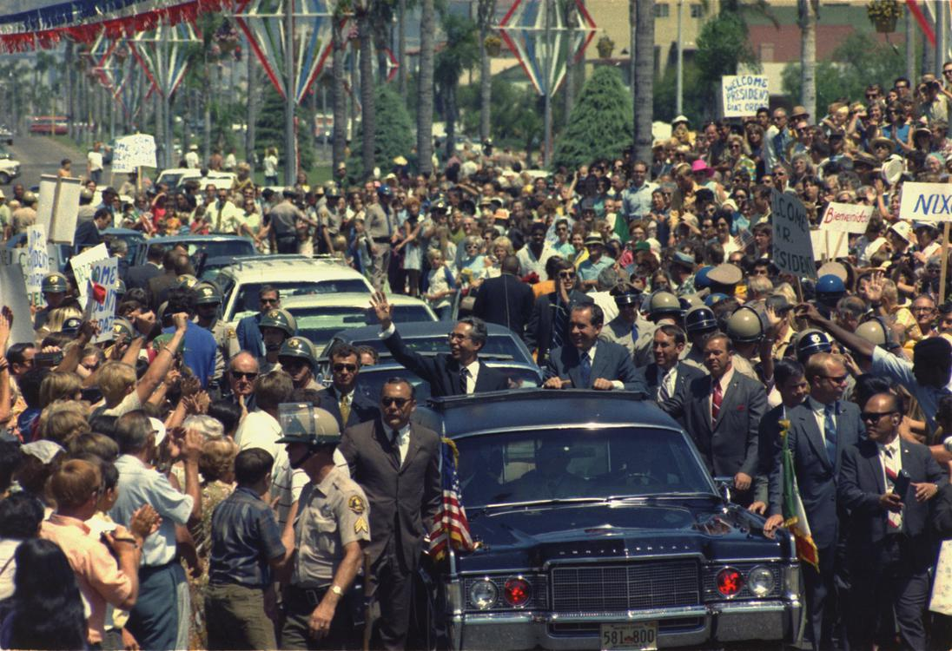
Nixon and Mexican president Gustavo Díaz Ordaz riding a presidential motorcade in San Diego, California, September 1970

Slide 34
Latin American policy
Nixon had been a firm supporter of Kennedy during the 1961 Bay of Pigs Invasion and 1962 Cuban Missile Crisis.
In August 1970, the Soviets asked Nixon to reaffirm the understanding; despite his hard line against Castro, Nixon agreed.
It was even alleged that "Nixon personally authorized" $700,000 in covert funds to print anti-Allende messages in a prominent Chilean newspaper.

Slide 35
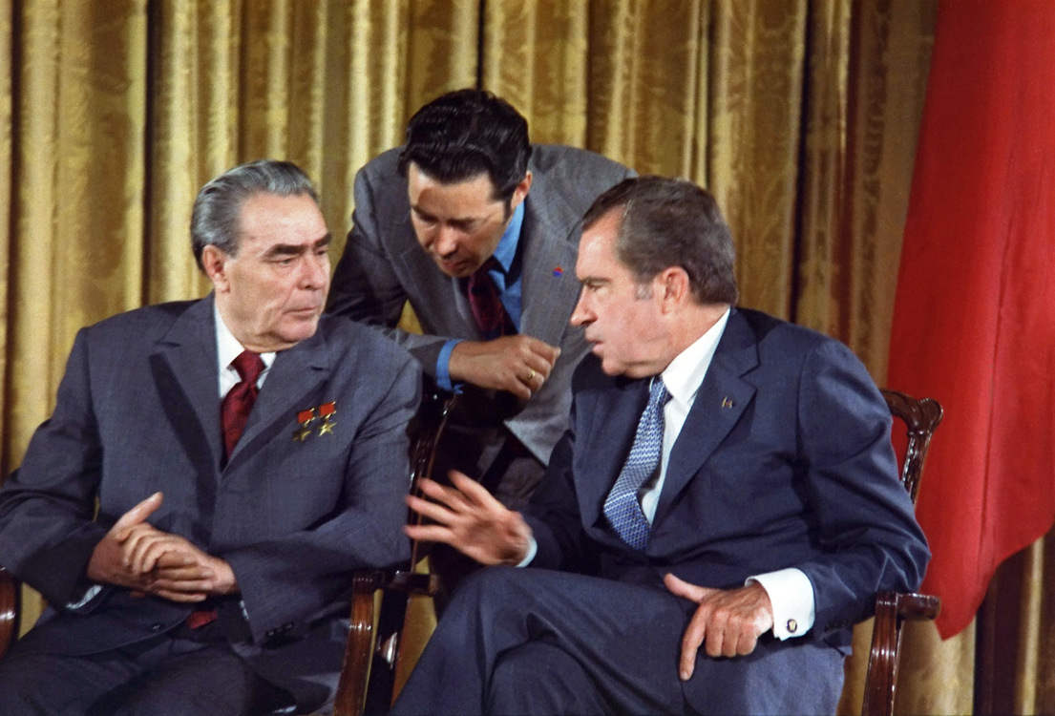
Nixon meets with Brezhnev during the Soviet leader's trip to the U.S., 1973

Slide 36
Soviet Union
Nixon used the improving international environment to address the topic of nuclear peace.
Nixon engaged in intense negotiations with Brezhnev.
Nixon and Brezhnev proclaimed a new era of "peaceful coexistence".
Nixon and Kissinger planned to link arms control to détente and to the resolution of other urgent problems through what Nixon called "linkage."
Nixon later described his strategy:

Slide 37
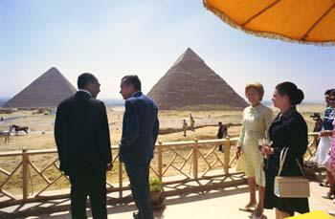
Nixon meets with President Anwar Sadat of Egypt, June 1974

Slide 38
Middle Eastern policy
The Nixon administration strongly supported Israel, an American ally in the Middle East, but the support was not unconditional.
Nixon believed that Israel should make peace with its Arab neighbors and that the United States should encourage it.
Brezhnev backed down as a result of Nixon's actions.
After the war, and under Nixon's presidency, the U.S. reestablished relations with Egypt for the first time since 1967.

Slide 39
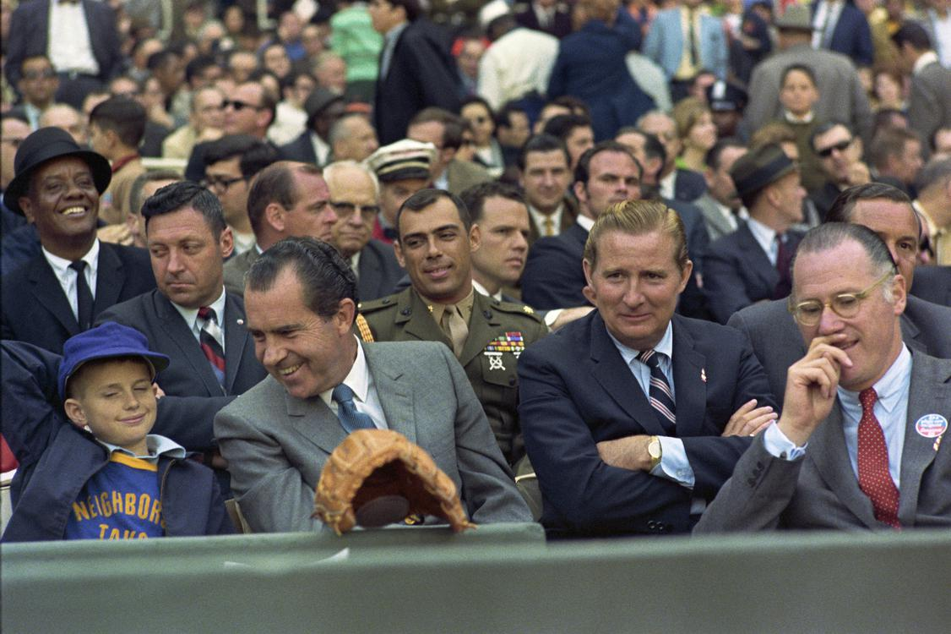
Nixon at the Washington Senators' 1969 Opening Day. Marine Corps Aide to the President Jack Brennan sits in uniform behind Nixon.

Slide 40
Economy
However, Nixon gained political credit for advocating them.
In 1970, Congress had granted the President the power to impose wage and price freezes, though the Democratic majorities, knowing Nixon had opposed such controls through his career, did not expect Nixon to actually use the authority.
After Nixon won re-election, inflation was returning.

Slide 41
President Nixon delivers the 1971 State of the Union Address at the U.S. Capitol

Slide 42
Governmental initiatives and organization
Nixon was a late supporter of the conservation movement.
Nixon broke new ground by discussing environmental policy in his State of the Union speech in 1970.
After Congress overrode his veto, Nixon impounded the funds he deemed unjustifiable.
Nixon was concerned about the prevalence of domestic drug use in addition to drug use among American soldiers in Vietnam.

Slide 43
Civil rights
The Nixon presidency witnessed the first large-scale integration of public schools in the South.
Federal aid was available, and a meeting with President Nixon was a possible reward for compliant committees.
Nixon opposed busing personally but enforced court orders requiring its use.
Nixon had campaigned as an ERA supporter in 1968, though feminists criticized him for doing little to help the ERA or their cause after his election.

Slide 44
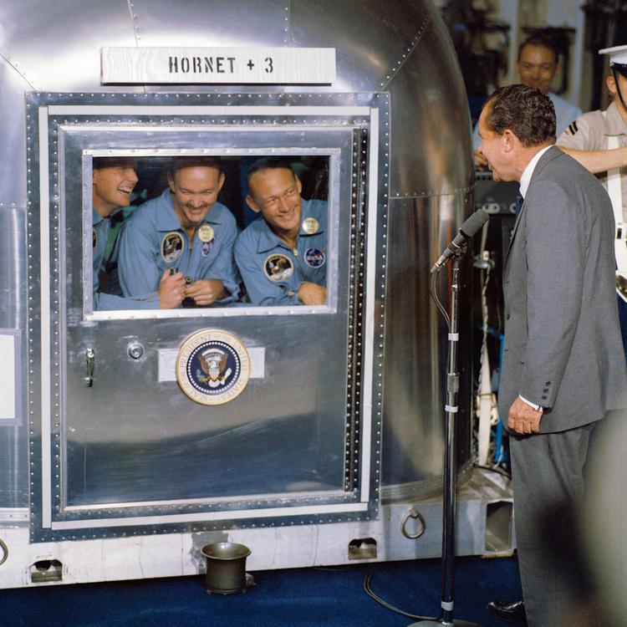
Nixon visiting the Apollo 11 astronauts in quarantine aboard USS Hornet

Slide 45
Space policy
Nixon spoke with Neil Armstrong and Buzz Aldrin during their moonwalk.
Nixon rejected both proposals due to the expense.

Slide 46
1972 presidential campaign
Nixon believed his rise to power had peaked at a moment of political realignment.
Nixon's efforts to gain Southern support in 1968 were diluted by Wallace's candidacy.
Nixon entered his name on the New Hampshire primary ballot on January 5, 1972, effectively announcing his candidacy for reelection.
The following month, Nixon was renominated at the 1972 Republican National Convention.

Slide 47
Nixon fielding questions at a press conference, October 26, 1973

Slide 48
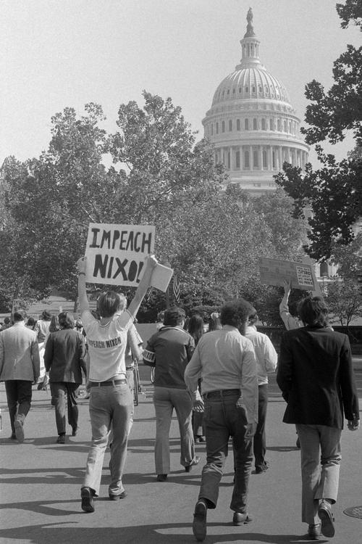
A demonstrator demanding Nixon's impeachment, October 1973

Slide 49
Watergate
Nixon downplayed the scandal as mere politics, calling news articles biased and misleading.
The gap, while not conclusive proof of wrongdoing by the President, cast doubt on Nixon's statement that he had been unaware of the cover-up.
Even with support diminished by the continuing series of revelations, Nixon hoped to fight the charges.
Rhodes told Nixon that he faced certain impeachment in the House.

Slide 50
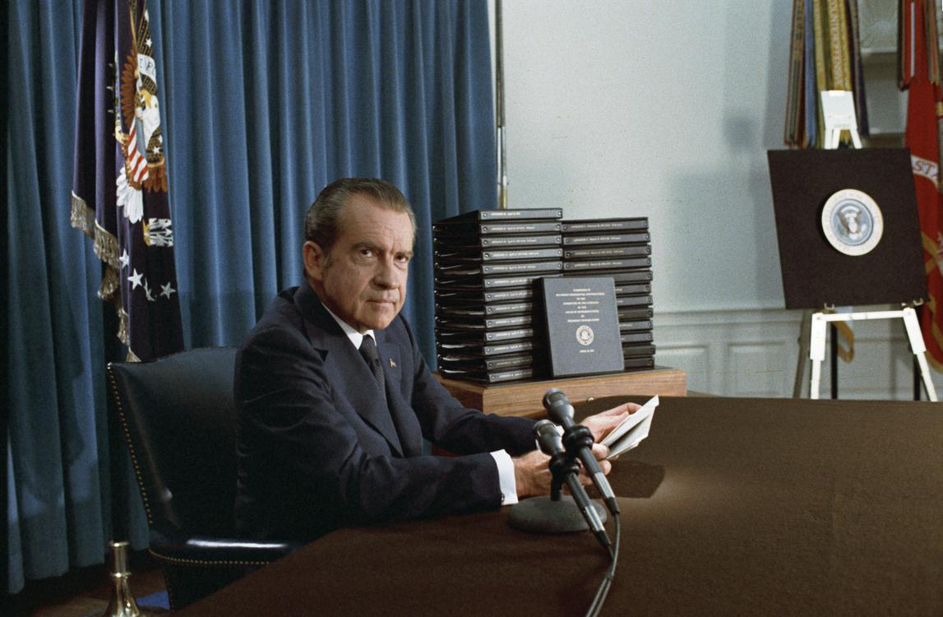
Nixon announces the release of edited transcripts of the Watergate tapes, April 29, 1974

Slide 51
Resignation
Nixon stated that he was resigning for the good of the country and asked the nation to support the new president, Gerald Ford.
Nixon went on to review the accomplishments of his presidency, especially in foreign policy.
Nixon's speech received generally favorable initial responses from network commentators, with only Roger Mudd of CBS stating that Nixon had not admitted wrongdoing.

Slide 52
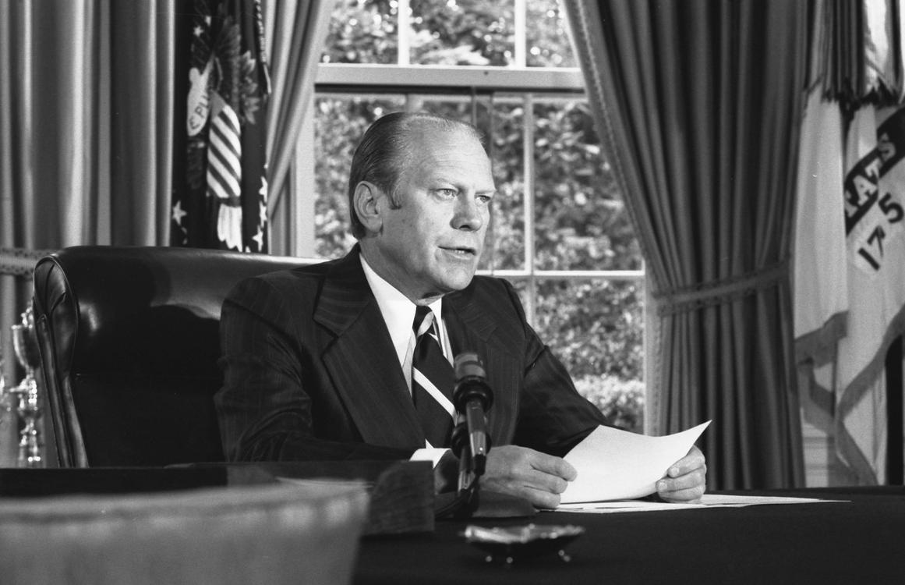
President Ford announcing his decision to pardon Nixon, September 8, 1974, in the Oval Office

Slide 53
Pardon and illness
With some of his staff still with him, Nixon was at his desk by 7 a.m.—with little to do.
Nixon then released a statement:
In October 1974, Nixon fell ill with phlebitis.
Nixon was under subpoena for the trial of three of his former aides—Dean, Haldeman, and John Ehrlichman—and The Washington Post, disbelieving his illness, printed a cartoon showing Nixon with a cast on the "wrong foot".
Judge John Sirica excused Nixon's presence despite the defendants' objections.

Slide 54
President Jimmy Carter, former Presidents Gerald Ford and Nixon meet at the White House in preparation for the funeral of former Vice President Hubert Humphrey, 1978.

Slide 55
Return to public life
By early 1975, Nixon's health was improving.
Nixon admitted that he had "let down the country" and that "I brought myself down.
In February 1976, Nixon visited China at the personal invitation of Mao.
Nixon chose not to present any defense.
In early 1978, Nixon went to the United Kingdom.
Nixon addressed the Oxford Union regarding Watergate:

Slide 56
Nixon speaking with Chinese Vice Premier Deng Xiaoping and U.S. President Jimmy Carter at the White House, 1979

Slide 57
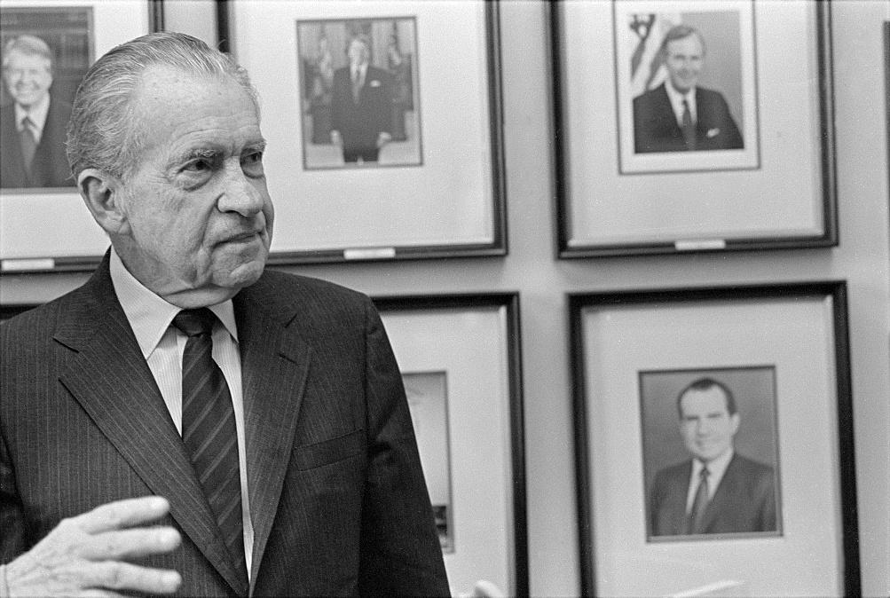
Nixon in 1992

Slide 58
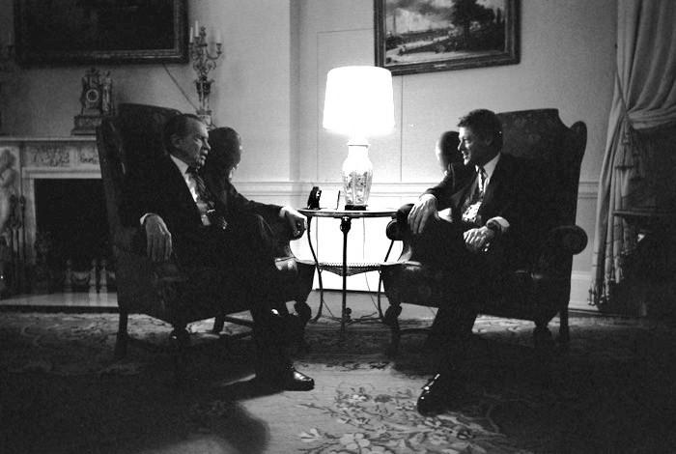
Nixon visiting President Bill Clinton in the White House family quarters, March 1993

Slide 59
Author and elder statesman
In 1978, Nixon published his memoirs, RN: The Memoirs of Richard Nixon, the first of ten books he was to author in his retirement.
Carter had not wanted to invite Nixon, but Deng had stated he would visit Nixon in California if the former president was not invited.
Her funeral services were held on the grounds of the Richard Nixon Library and Birthplace.

Slide 60
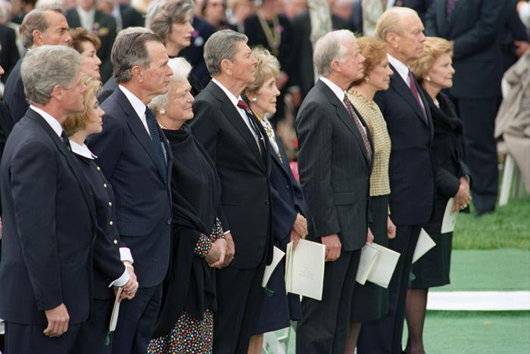
Five U.S. Presidents (including then-incumbent President Bill Clinton) and their wives attending the funeral of Richard Nixon, April 27, 1994

Slide 61
Death and funeral
Richard Nixon was buried beside his wife Pat on the grounds of the Nixon Library.
John F. Stacks of Time magazine said of Nixon shortly after his death,
Tom Wicker of The New York Times noted that Nixon had been equalled only by Franklin Roosevelt in being five times nominated on a major party ticket and, quoting Nixon's 1962 farewell speech, wrote,

Slide 62
Legacy
Nixon's biographers disagree on how he will be perceived by posterity.
During the impeachment of Bill Clinton in 1998, both sides tried to use Nixon and Watergate to their advantage: Republicans suggested that Clinton's misconduct was comparable to Nixon's, while Democrats contended that Nixon's actions had been far more serious than Clinton's.

Slide 63
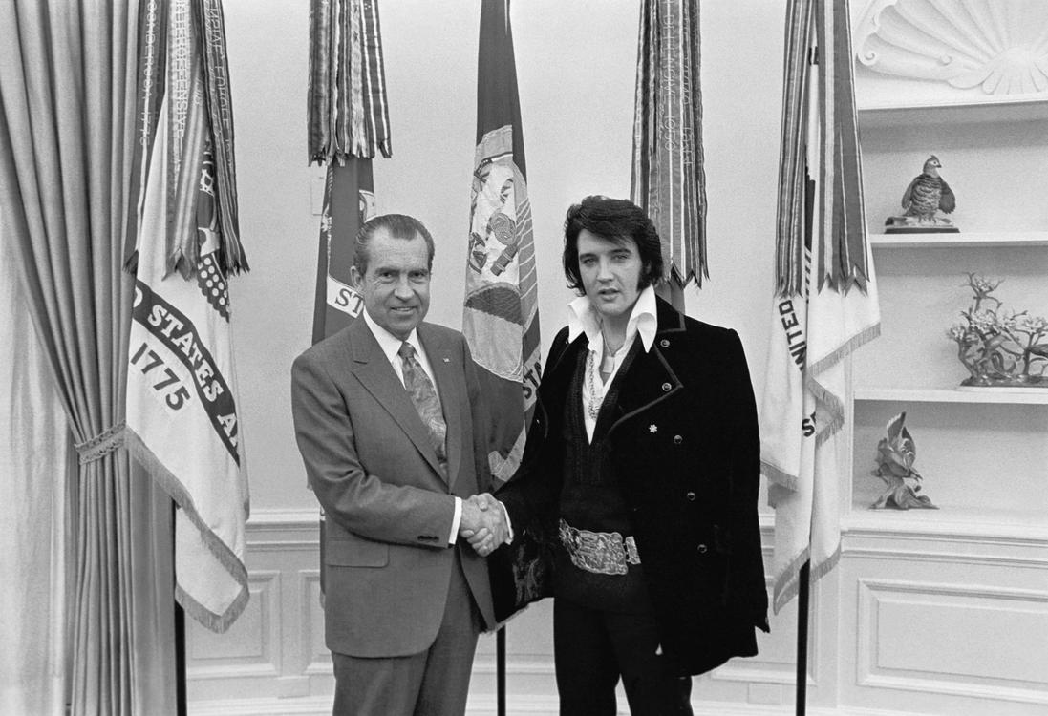
Nixon and Elvis Presley in December 1970: "The President & The King"

Slide 64
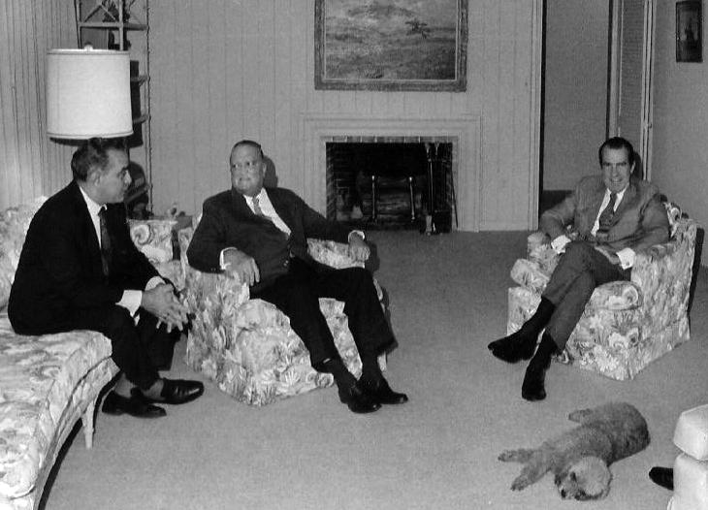
Bebe Rebozo, FBI Director J. Edgar Hoover, and Nixon relax before dinner at Key Biscayne, Florida, December 1971

Slide 65
Personality and public image
Nixon's career was frequently dogged by his persona and the public's perception of it.
According to Black, Nixon
In his account of the Nixon presidency, author Richard Reeves described Nixon as "a strange man of uncomfortable shyness, who functioned best alone with his thoughts".
Nixon's presidency was doomed by his personality, Reeves argues:
Nixon stated of this,

Slide 66
See also
Murray Chotiner, Nixon's campaign manager and aide

Slide 67
Nixon Library
Richard Nixon Presidential Library and Museum.
Richard Nixon Presidential Library and Museum.
"The Nixon Family".
Richard Nixon Presidential Library and Museum.
Richard Nixon Presidential Library and Museum.
Richard Nixon Presidential Library and Museum.
Richard Nixon Presidential Library and Museum.
Richard Nixon Presidential Library and Museum.
Richard Nixon Presidential Library and Museum.
"Guide to the Nixon Family Collection (1909–1967)".
Richard Nixon Presidential Library and Museum.

Slide 68
Other sources
"Nixon Resigns".
"Richard M. Nixon, 37th President, dies".
"Nixon: I Am Not an Anti-Semite".
"Richard Nixon: Victory in Defeat".
"Richard M. Nixon Birthplace".
"President Nixon's Resignation Speech".
"Nixon Becomes President".

Slide 69
Further reading
Farrell, John A (2017) Richard Nixon: The Life New York: Doubleday
Nixon in New York: How Wall Street Helped Richard Nixon Win the White House.
Being Nixon: A Man Divided.

Slide 70
External links
Nixon Presidential Library and Museum
Richard Nixon Foundation
"Richard Nixon collected news and commentary".
"Richard Nixon (id: N000116)".
Works by or about Richard Nixon at Internet Archive
Richard Nixon Personal Manuscripts
Richard Nixon on IMDb

